Slide 1
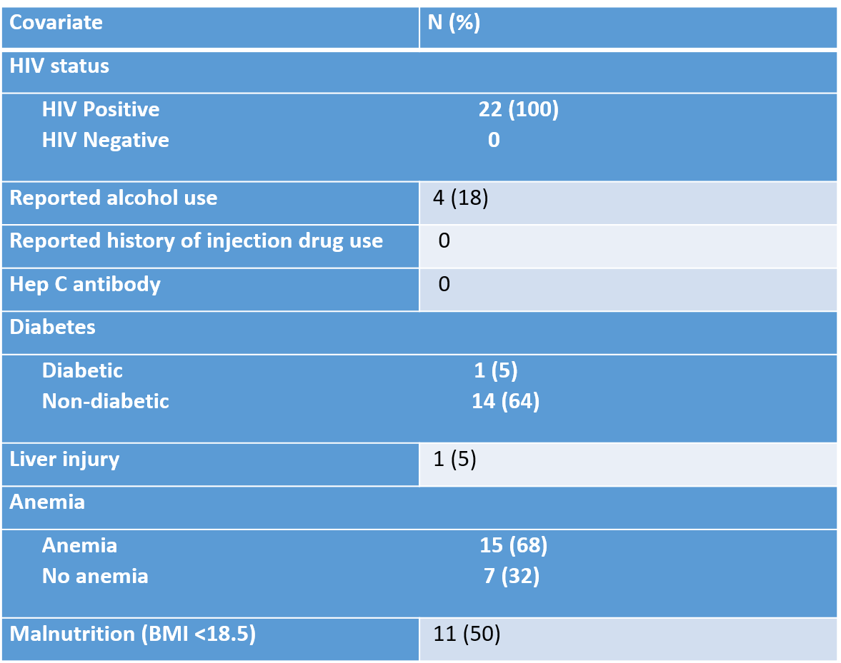
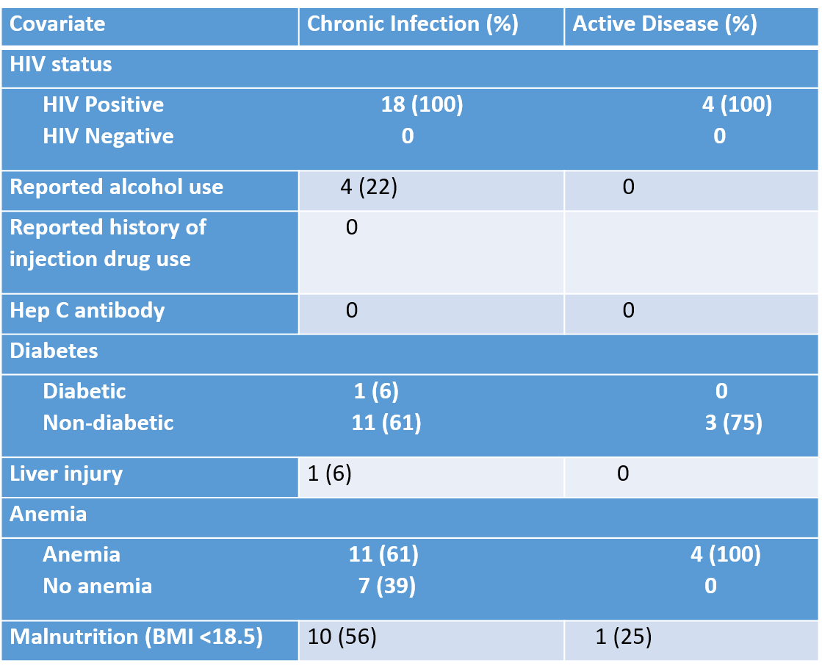
Hepatitis B co-infection in HIV-infected patients receiving Multi-drug Resistant Tuberculosis (MDRTB) treatment at Botsabelo Hospital, Lesotho.
Authors: Lawrence Oyewusi, Meseret Tamirat, Mpinda Stephanie, Joalane Makaka, Mabatloung Mofolo, Melino Ndayizigiye, KJ Seung, Patrick Nkundanyirazo, David Holtzman
Introduction
Partners In Health is a global health organization that works within governments’ public health infrastructure to support a full continuum of care for over 35,000 people living with HIV in Haiti, Malawi, Lesotho, Sierra Leone, and Liberia.
Partners In Health Lesotho has been supporting the Ministry of Health since 2006 in the management of MDRTB and also primary healthcare service delivery in 7 remote hard to reach areas of Lesotho. This collaboration has strengthened the health system in the country over the years.
Background
Lesotho is facing high burden of infectious diseases including HIV, TB and others. Hepatitis B is known to be highly prevalent in regions with high burden of HIV and causes liver injuries that might worsen drug resistant TB treatment (DR TB) liver toxicity.
Previously, there was no documented evidence of any association between HBV and HIV co-infection in Lesotho.
Our study aims to assess HBV and HIV co-infection rate among cohort of Rifampicin Resistant Tuberculosis (RR TB) patients in Lesotho.
Design/Methods
A cohort of patients with RR TB enrolled in endTB observational study in Lesotho from October 2015 to September 2018 was studied.
All patients have been screened for Hepatitis B (Hepatitis B Surface Antigen), HIV, malnutrition, anaemia and alcohol use at baseline and results were captured in patients files and Electronic Medical Record (EMR) system.
We used existent aggregated and verified data to assess the proportions of Hepatitis B and other comorbidities in the cohort.
Results
Among the 244 patients enrolled for the observational study, Hepatitis B Surface Antigen Positivity rate was 7.4% (18) and 100% (22) of patients with HB co-infection also had HIV co-infection compared to 79% without HB co-infection. Among patients with chronic hepatitis, 15 (68%) were found to be anemic. (Table 1a).
Rates of baseline liver injury were common among participants with and without HB co-infection (6% in both groups). (Table 1a & b)
However, the average baseline values of alanine aminotransferase and aspartate aminotransferase were higher among individuals with HB co-infection.
Conclusion
We found a significant rate of HB co-infection among HIV positive, MDRTB patients.
This finding confirms the need for testing HIV positive patients for Hepatitis B and the need to design an algorithm for the management of Hepatitis B Virus infection in Lesotho.
Table 1a: Chronic Hep B
Table 1b: Chronic Hep B vs Active Hep B
PRESENTED AT THE 23RD INTERNATIONAL AIDS CONFERENCE (AIDS 2020) | 6-10 JULY 2020

